Slide 1
Java Dojo @ LV 1871 Chatbot mit IBM Cloud
München, xx. April 2018
INFOMOTION

Slide 2
Agenda
Einführung
INFOMOTION
IBM Cloud (Watson Assistant)
Chatbots
Entwicklung Chatbot
Chatbot mit Watson Assistant
Integration in ein Orchestration Layer
Anbindung an ein User Interface
Erweiterungen
Wrap-up
Wie geht es weiter?
Lessons Learned

Slide 3
Vorstellung

Slide 4

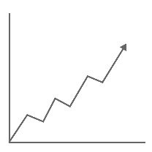
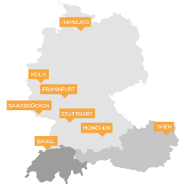


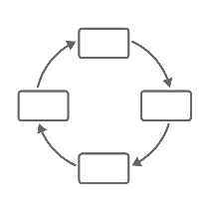










INFOMOTION: Unser Erfolgsgeheimnis? We love data!
Business Intelligence, Big Data & Digital Solutions
8 Standorte
DACH Region
13 JAHRE WACHSTUM
300 MITARBEITER
350+ KUNDEN
ALLER BRANCHEN
FULL SERVICE-anbieter
INFOMOTION LAB
STARKE Kooperationen
STARKE Kooperationen

Slide 5
Only IBM delivers an architecture engineered for disruption
Applications, solutions and services
Targeted solutions for enterprise businesses
Watson
Oncology
Watson
Cyber Security
Weather
IBM Services and Industry Solutions
Watson
Virtual Agent
Watson Explore and Discover
IBM Risk and Compliance
Asset Management (Maximo)
AI
Cognitive building blocks for developers
Conversation
Discovery
Compare and Comply
DLaaS
Tone Analyzer
Personal Insight
API
API
API
API
API
API
API
Visual Recognition
API
Speech
API
Document Conversion
API
Nat Language Understanding
API
Nat Language Classifier
API
Knowledge Query
Data
Tools to prepare data for cognitive
Ingestion
Storage
Analytics
Deployment
Governance
Cloud Infrastructure
A highly scalable, security enabled infrastructure
Cloud Integration
Cognitive Micro-services
DevOps Tooling
Networking
Security
Core Enterprise Infrastructure
Cognitive
Systems
Virtual Servers
Object Storage
File Storage

Slide 6
With Watson you can harness the power of augmented intelligence
Your data + the world’s data Watson can ingest, cleanse, and comprehend multiple data types. Build off your domain expertise and the largest base of industry offerings in the market.
Ingests + transforms Apply a powerful suite of Watson services and APIs to transform your data into valuable insights. Watson is optimized for robust AI workloads and lives on IBM Cloud.
Insights + outcomes Watson extracts meaning to provide deep insights and produces powerful outcomes. Train your AI on what’s important to your industry gain knowledge and make the most informed, reasoned decisions.
Unstructured
Structured
Transform
Insights

Slide 7
Four capabilities differentiate Watson from traditional programmed computing systems
Understand Watson understands like humans do.
Reason Watson reasons. It understands underlying ideas and concepts. It forms hypotheses. It infers and extracts concepts.
Learn Watson never stops learning, getting more valuable with time. Advancing with each new piece of information, interaction and outcome, it develops “expertise.”
Interact With abilities to see, talk and hear, Watson interacts with humans in a natural way.
Notes:
Understand: Two key attributes define understand. First, the ability of a system to navigate the complexities of human speech– understanding the idiosyncrasies, colloquialisms and knowing the ways we would express ourselves to one another. This is not an easy task. We say things like, “This morning I got a haircut.” This could reference the barbershop, OR a bad financial trade. The second attribute is being able to put content into context- not search and keyword– but actually bringing forward relevant, actionable content.
Reason: There are very few times where we, as humans, are presented with information that is useful WITHOUT having to infer from the data to extract what we need for our purposes. In doing so, we are reasoning with a purpose– often generating a hypothesis and then proving out the theory. This is something cognitive systems, like Watson, can do.
Learn: Cognitive systems are fundamentally different from traditional computational computers, which are hard coded with rules and logic, following a decision tree format. Cognitive systems get progressively smarter with each outcome, action, iteration– with each new peace of information.
Interact: With abilities to see, talk and hear, cognitive systems interact with humans in a natural way.

Slide 8
With Watson you can_
Accelerate research and discovery
Conduct rigorous, domain-specific research faster, uncovering insights and new opportunities by combing through diverse data sources and extracting the information you find most important.
Detect liabilities and mitigate risk
Understand the written language of threat reports, regulations, and new findings, keeping your business up to date and shielding it from risk on all sides.
Recommend with confidence
Make more confident, targeted recommendations by drawing from a broad set of information and understanding the nuances of your current context.
Scale expertise and learning
Elevate the expertise of every employee by collecting individual knowhow from across your organization and combining it with the latest lessons learned in your industry, creating a deep source of tribal knowledge that's available to all of your employees on-demand.
Enrich interactions
Understand and communicate with your customers and employees around the clock, responding to their needs with tailored dialogue and personalized, adaptive experiences.
Assess and preempt disruptions
Monitor the condition of your systems and equipment at all times, allowing you to catch potential issues before they lead to bigger, more expensive problems down the road.
Notes:
With Watson you can.
Speaker to select two or three examples from the chart to illustrate Watson capabilities.
Enrich interactions: Autodesk
Detect liabilities: Cog Security
Scale expertise: Woodside

Slide 9
Watson services
How Watson sees, hears, speaks, feels, translates, finds
Speech
Text to Speech
Vision
Speech
to Text
Visual Recognition
Discovery
Knowledge
Studio
Language
Discovery News
Natural Language Classifier
Discovery Service
Empathy
Tone Analyzer
Retrieve and Rank
Language Translator
Personality
Insights
Natural Language Understanding
Conversation Service
Virtual Agent
Conversation
Notes:
For more details on each service go to: http://ibm.biz/watsonplatform

Slide 10
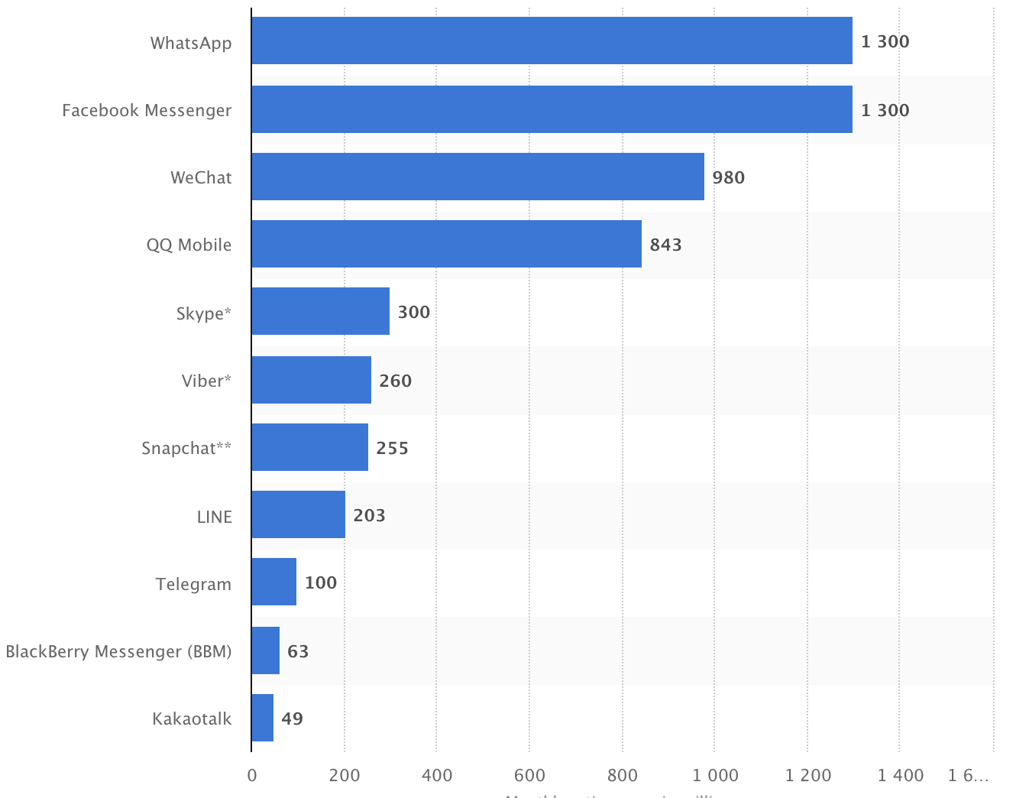
Warum Chatbots?

Slide 11
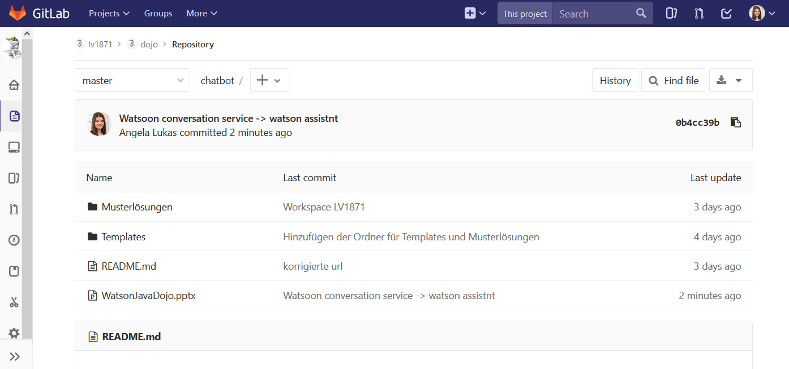
Alle Informationen zum Nachlesen
https://gitlab.infomotion.de/lv1871/chatbot

Slide 12
Ziel des Dojos: Entwicklung eines vollständigen Chatbots
…
IBM Cloud (WCS)
Orchestration Layer
Online Sterbegeldrechner

Slide 13
Zeitplanung Katas
Dauer | Kata | Beschreibung
20 min | Erstelle einen Watson Assistant Dialog | Dialog erstellen Intents & Entities verbessern Analyse von Konversationen
30 min | Verbinde Watson Assistant mit dem Orchestration Layer | Integration der Watson SDK Anbindung an Watson Assistant
15 min | Verbinde den Sterbegeldrechner mit der Api der LV 1871 | Anbindung API LV1871 Übergabe von Kontextvariablen
15 min | Erweitere das System | Logging ‚Chit Chat‘ Integration des User Interface

Slide 14
Katas

Slide 15
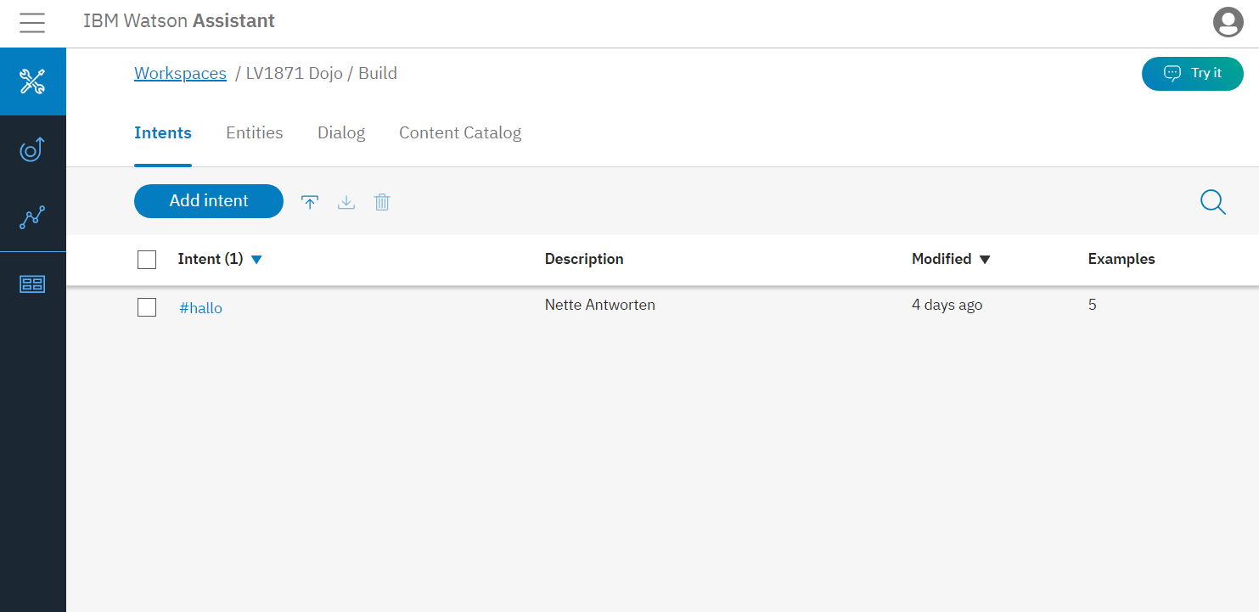
Kurzeinführung Watson Assistant
Notes:
Slides mit Screenshot
Detailfolie
Cheat Sheet / FAQ

Slide 16
Kata 1: Watson Assistant
Problembeschreibung
Anwendungsfälle
Erstelle einen Workspace
Erstelle einen einfachen Dialog
Erweitere Intents und Entities
Nutzer kann den Chatbot begrüßen
Nutzer wird nach der Summe für Sterbegeld gefragt
Eingegebene Summe wird erkannt und im Kontext gespeichert
Hinweise
Ressourcen
Intents sind die Verben des Chatbots
Entities sind die Substantive des Chatbots
Help: Workspace Configuration
Help: How to build a chtabot
Template:
(JSON Template)

Slide 17
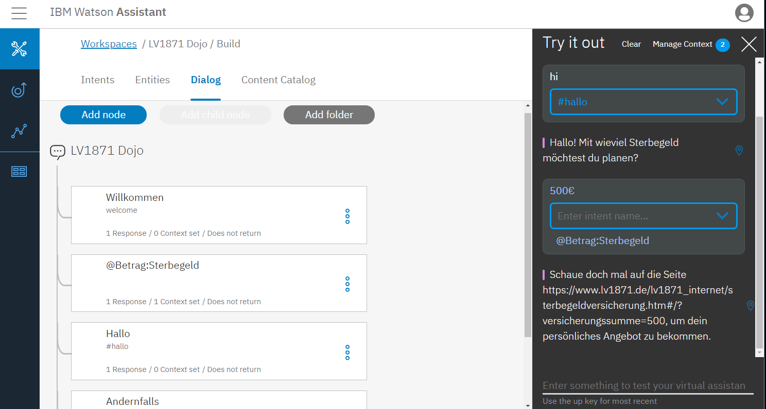
Kata 1: Watson Conversation
Komplette Lösung: gitlab.infomotion.de/lv1871/chatbot/wcs_full.json

Slide 18
Kata 2: Orchestration Layer
Problembeschreibung
Anwendungsfall
Importiere die Basisversion des Projekts
Füge Workshop-ID ein
Nutze Konsole als User Interface zu WC
Nutzer kann über die Konsole mit WCS kommunizieren
Hinweise
ResSourcen
Verifiziere die Installation mit Junit Test Cases
Erweitere den Junit Testfall für WCS
Watson Developer Cloud / Java SDK: Integration and documentation
Template:

Slide 19
Kata 2: Orchestration Layer
public MessageResponse respond(String inputText, Context context) {
InputData input = newInputData.Builder(inputText).build();
MessageOptions options = new MessageOptions.Builder(WORKSPACE_ID)
.context(context) // output context from the first message
.input(input).build();
MessageResponse response = service.message(options).execute();
System.out.println(response);
return response;
}
Komplette Lösung:
gitlab.infomotion.de/lv1871/chatbot/orchestration_layer_full

Slide 20
Kata 3: LV 1871 API
Problembeschreibung
Anwendunsfall
Die Summe für das Sterbegeld wird aus dem Kontext ausgelesen
Der Link zu der LV1871 wird automatisch erstellt
Bei Eingabe der Sterbegeldsumme wird ein direkter Link angezeigt
Hinweise
ResSourcen
Grenze die minimale und maximale Höhe des Wertes ein
www.lv1871.de/lv1871_internet/sterbegeldversicherung.htm#/?versicherungssumme=9000
Template:

Slide 21
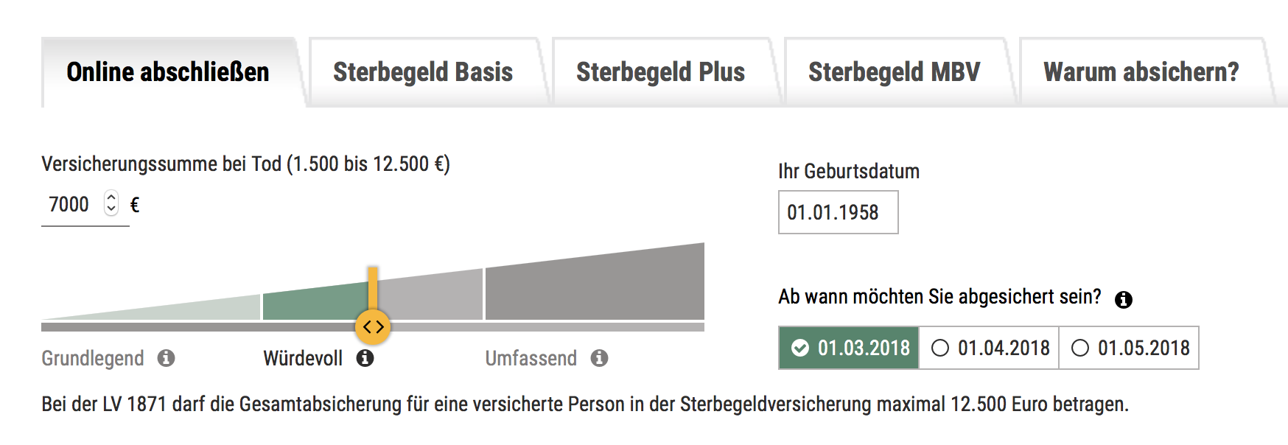
Kata 3: LV 1871 API
Komplette Lösung:
gitlab.infomotion.de/lv1871/chatbot/orchestration_layer/
src/main/resources/chatbot.LvApiService.java

Slide 22
Kata 4: Erweiterungen
Problembeschreibung
Anwendungsfälle
Füge eine UI hinzu
Bringe dem Chatbot Chit Chat bei
Logge Ein- und Ausgaben
Erstelle einen Backup des Workspace
Nutzer chattet über eine UI
Chatbot beantwortet eine Frage zum Wetter
Administrator kann den Chatverlauf in der Datenbank nachverfolgen
Hinweise
ResSourcen
Es darf keinen einzelnen Intent mit allen Chit Chat geben (Dominanz eines Intents)
Watson Assistant GUI API
Template:

Slide 23
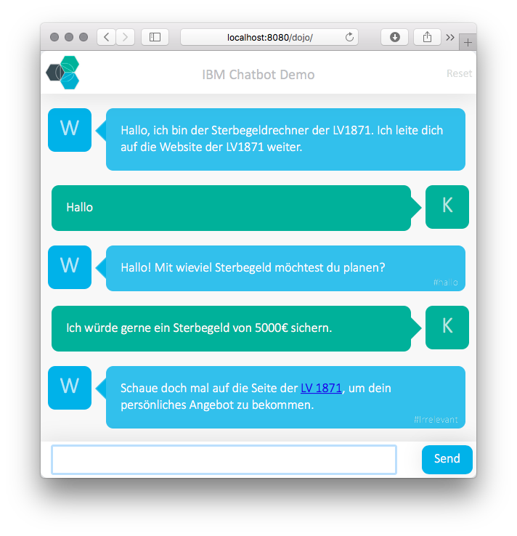
Kata 4: Erweiterungen
Komplette Lösung:
gitlab.infomotion.de/lv1871/chatbot/orchestration_layer_extended

Slide 24
Wrap-up

Slide 25
Erweiterungen
Weitere Parameter abfragen
Weitere Versicherungen anbieten und danach fragen
...
Chatbot
Anbindung von Logik aus Online-Rechner
Feedback auf Basis von Kundenprofilen
...
Orchestration Layer
Integration in WhatsApp und andere Messenger
...
Sonstiges

Slide 26
Lessons Learned
Architektur eines Chatbots
Watson Assistant als erweiterbare Lösung
Anbindung an einen Orchestration Layer
...
…
IBM Cloud (WCS)
Orchestration Layer
Online Sterbegeldrechner

Slide 28
INFOMOTION GmbH
Michael Löbbert
Dr. Nicolai Erbs
Lead Consultant
Senior Consultant
INFOMOTION GMBH
Ludwigstraße 33-37
60327 Frankfurt
T +49 69 97460-730 F +49 69 97460-799
M +49 176 61635267
INFOMOTION GMBH
Ludwigstraße 33-37
60327 Frankfurt
T +49 69 97460-739 F +49 69 97460-799
www.infomotion.de
michael.loebbert@infomotion.de
www.infomotion.de
nicolai.erbs@infomotion.de
Alle Angaben basieren auf dem derzeitigen Kenntnisstand. Änderungen vorbehalten. Dieses Dokument der INFOMOTION GmbH ist ausschließlich für den Adressaten bzw. Auftraggeber bestimmt. Es bleibt bis zu einer ausdrücklichen Übertragung von Nutzungsrechten Eigentum der INFOMOTION GmbH. Jede Bearbeitung, Verwertung, Vervielfältigung und/oder gewerbsmäßige Verbreitung des Werkes ist nur mit Einverständnis der INFOMOTION GmbH zulässig.

